Slide 1

MSIS LAB
Introduction To
MSIS Lab Research
(Wireless Sensor Network Areas)
2018. 05
Prof. HyungWon Kim
MSIS LAB
Department of Electronics Engineering
Chungbuk National University

Slide 2
MSIS Lab’s Research (Sensor Network)
Other Research: Deep Learning AI & Image Recognition
◇ Object and Environment Recognition for Smart Car (Autonomous Vehicle)
◇ Multi-Sensor Fusion Algorithm for Vehicle Tracking Enhancement
◇ Multi-Vehicle Senor Fusion Using V2X (Vehicle-to-Anything) Communication
◇ Moving Object Detection, Classification, Identification, Tracking with Fast CNN (Convolutional Neural Network)
◇ Low Power & Compact Neural Network Algorithm for IoT (Internet of Things)
◇ Image Recognition for IoT Sensors (Wireless Metering, Environment monitor)
◇ Embeded Programming on ARM Cortex M4, Cortex A9, with RTOS, Linux
Other Research: Smart Car V2X Network & Wireless Sensor Network
◇ Enhanced V2X Network for transmitting Sensor data & Safety Decision
Inforamtion between Smart Cars (Autonomous Vehicles)
◇ Multi-Hop Reliable Broadcast with TDM Scheduling for High speed, low latency, guaranteed delivery of congested V2X networks
◇ Wide-Range LDM (Local Dynamic Map) Generation and transmission method
◇ Automonous driving safety decision algorithms using Wide-Range LDM:
FCW (Forward collision warning), LCW (Lane change warning), EEBL (Electronic
Emergency Brake), IMA (Intersection Movement Assist), LTA (Left Turn Assist)

Slide 3
P
02
art
Wireless Sensor Network /
IOT Sensor Platform

Slide 4
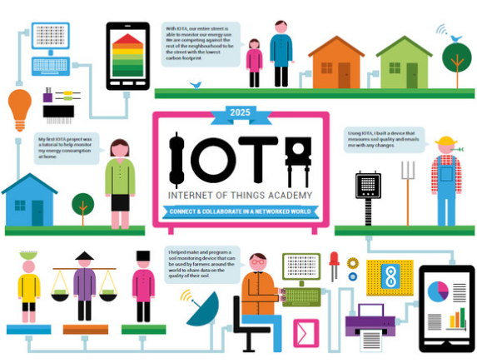
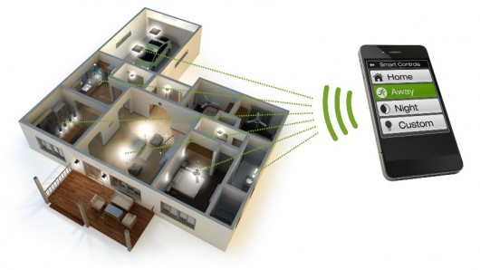
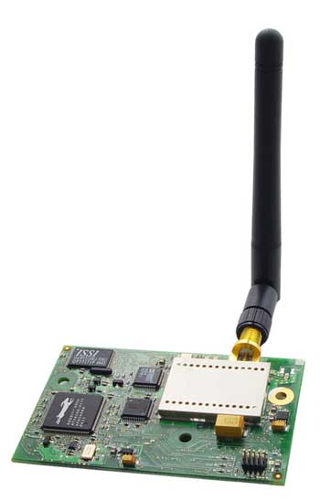
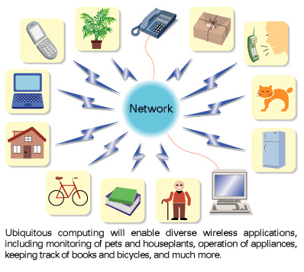
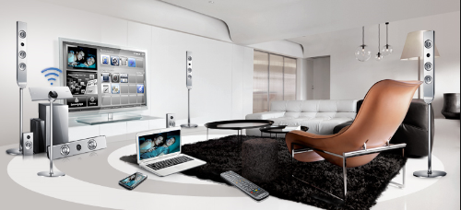
Wireless Sensor Network for IoT (Internet of Things)
IoT’s 3 components: Integration of Sensors, wireless, intelligence

Slide 5
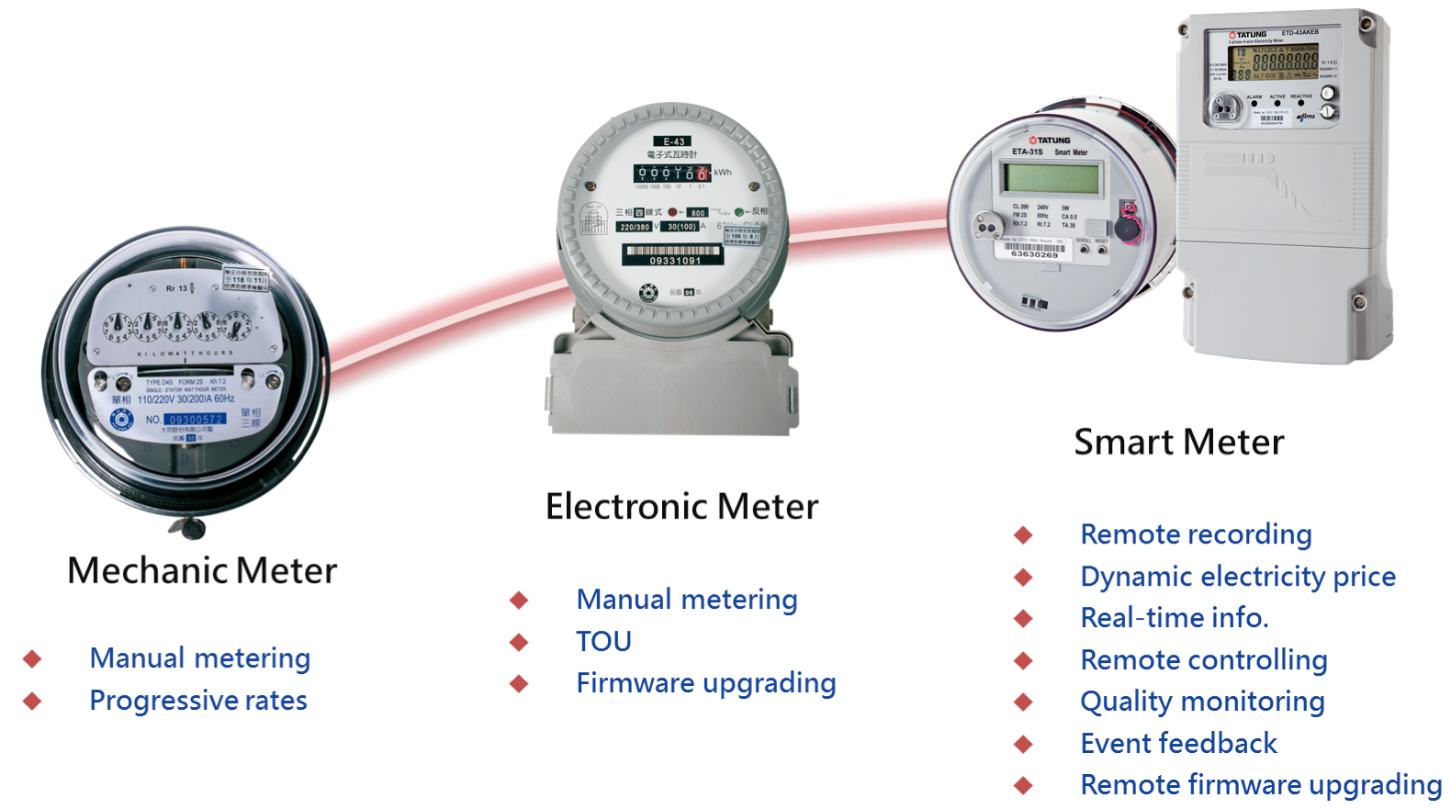
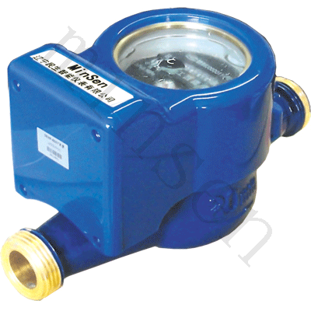
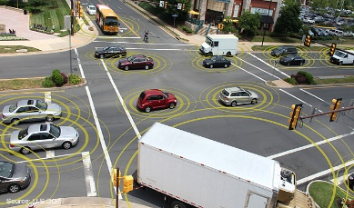
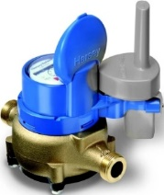
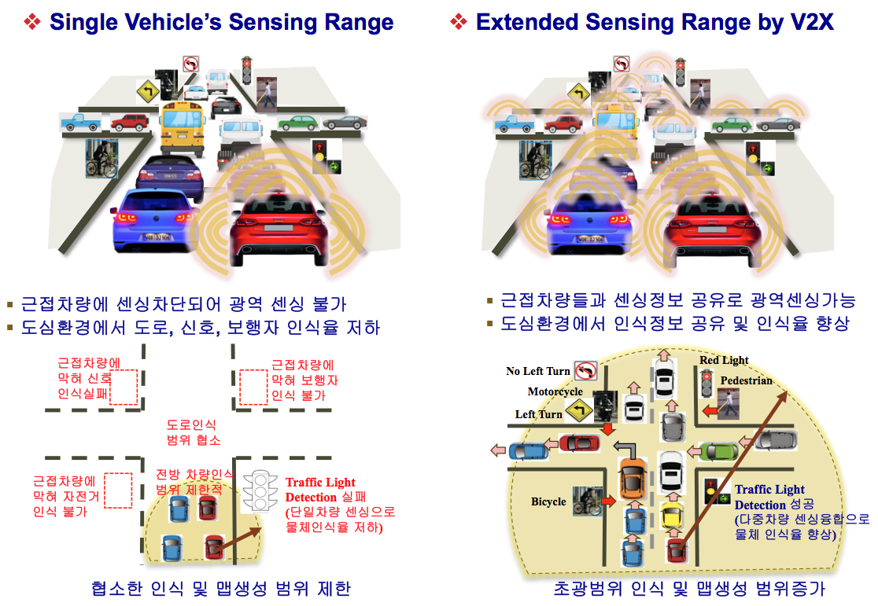
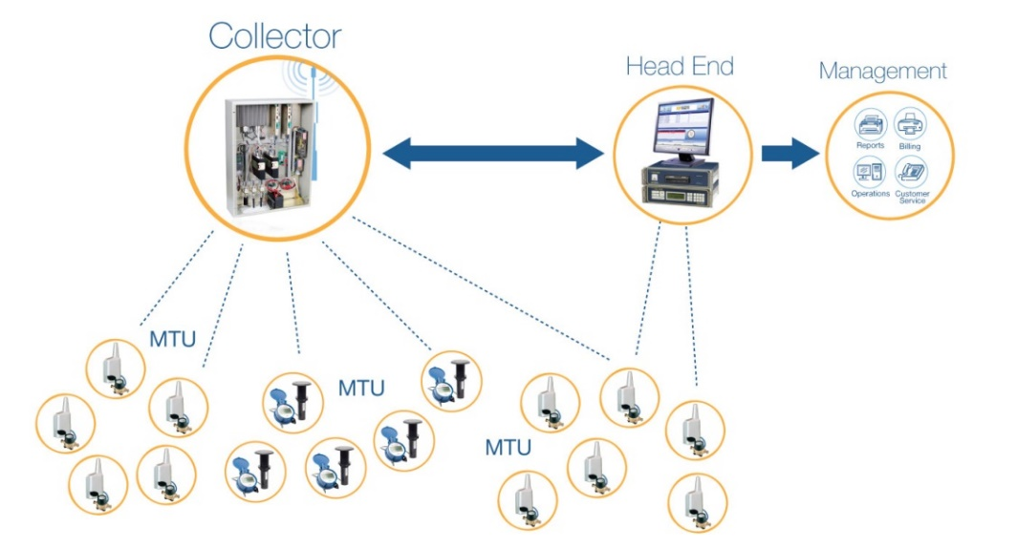
Wireless Sensor Network For Smart Metering & Smart Cars
Low Power Wireless Meter Recognition
Problem: 전자식계량기 교체 후 무선검침:시장확대 문제
Problem: 기존 계량기에 영상저장 후 PDA로 전송: 검침원 문제
Solution: 영상인식 자동검침 후 저전력 무선전송
Smart Car V2X Network
Problem: Single Car 센싱 ADAS & 자율주행➔ 센싱범위문제
Problem: Using WAVE Standard ➔ 다중차량 통신 성능저하
Solution: Multi-channel Scheduled Cluster Network ➔ Guaranteed packet delivery for large scale dynamic V2X network
무선검침용 계량기의 예시

Slide 6
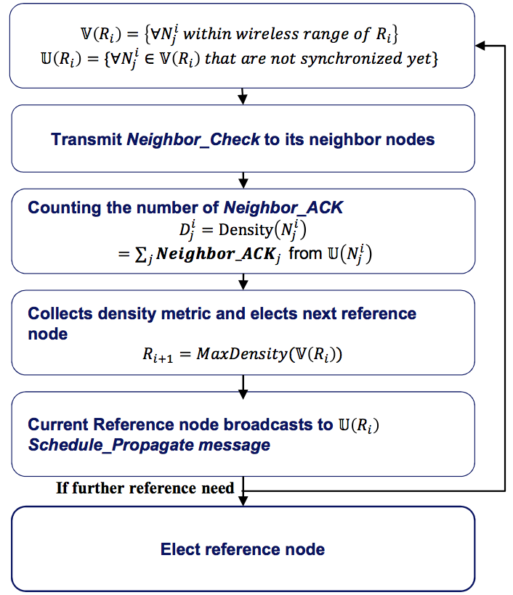
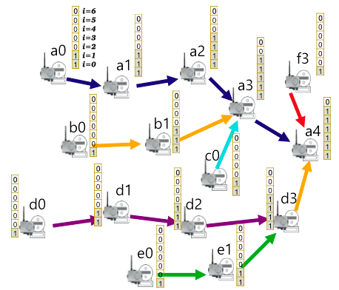
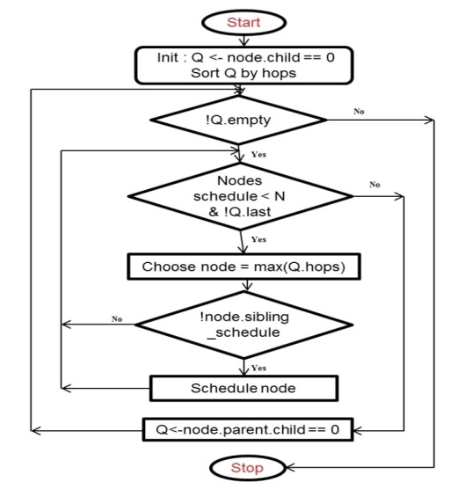
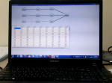
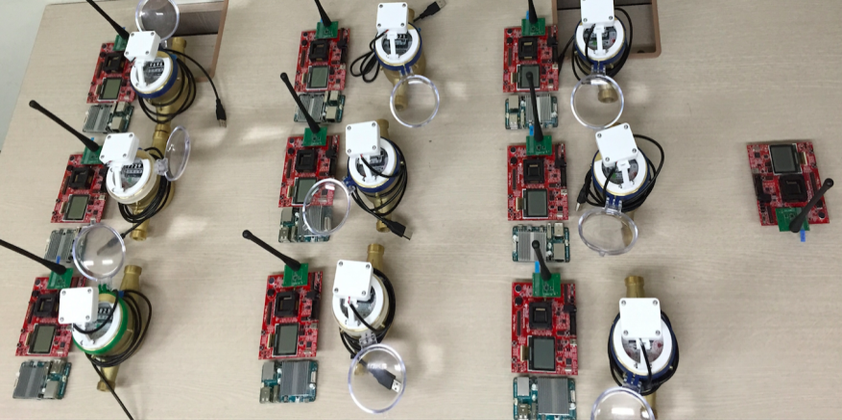
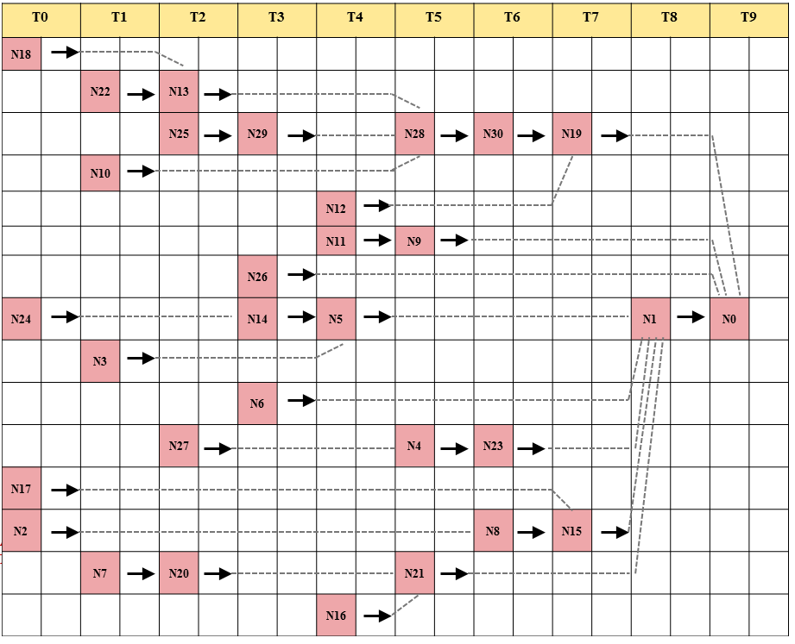
Multi-channel Mesh Network
TDM-CSMA Hybrid MAC Developed
Maximal Utilization, Lowest Power, and Still High Availability (Reliability)
Network Algorithms & Protocols Developed
Synchronization / Scheduling / Routing / Ch. Allocation / Centralized / Distributed
Density- Based Synch Algorithm
Optimum Scheduling (BLP)
Heuristic Scheduling
Real Experiment /w Water Meter Network
CH0
CH0
CH0
Multi-Ch. TDM Scheduling
CH20
CH20
CH0
CH0
CH40
CH40
Level1
Level2
Level3
S1
S1
S1
S2
S3
6

Slide 7
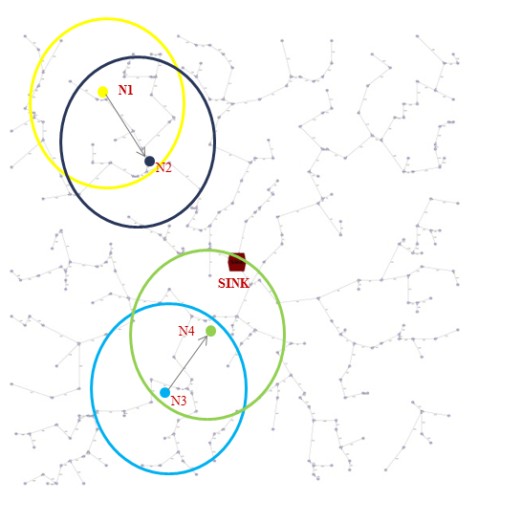
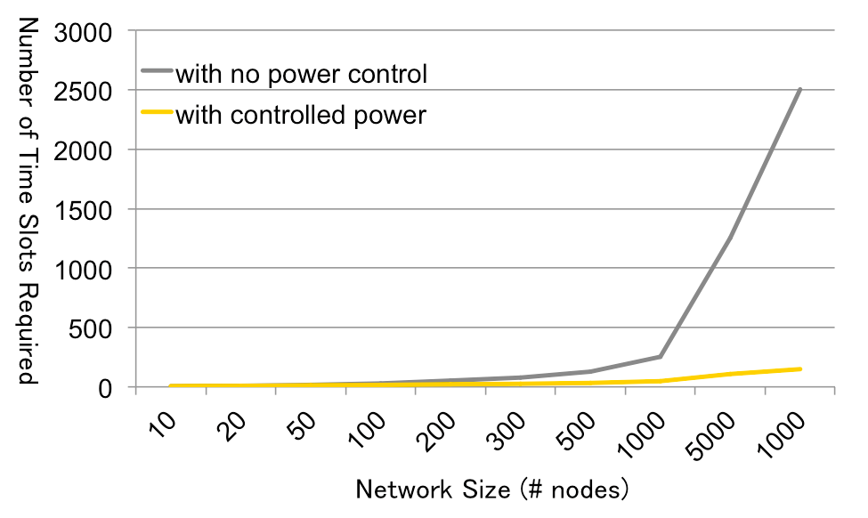
Heuristic Scheduling Algorithm (With TX Power Control)
Non-overlapping Wireless ranges due to Reduced TX power
Objectives: Pack more node into fewer slots
Key Approach: Reduce the TX power to reduce the wireless range
Benefit from the Reduced TX power:
Reduce Power Consumption
Allow more node to share the same time slot & channel
Conditions to Share slot & Channel
2 Nodes who do not interfere with each other (Non-overlapping wireless ranges)
Example (Right network)
N1 transmits to N2, N3 transmits to N4
N1 and N2’s wireless ranges do not overlap
Then 2 Links (N1 → N2) and (N3 → N4) can be allocated to the same time slot and channel.
Simulation Result of Algorithm1 & 2

Slide 8
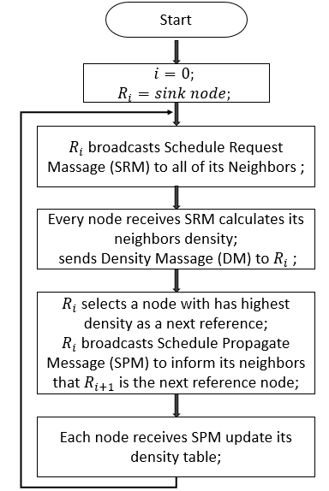
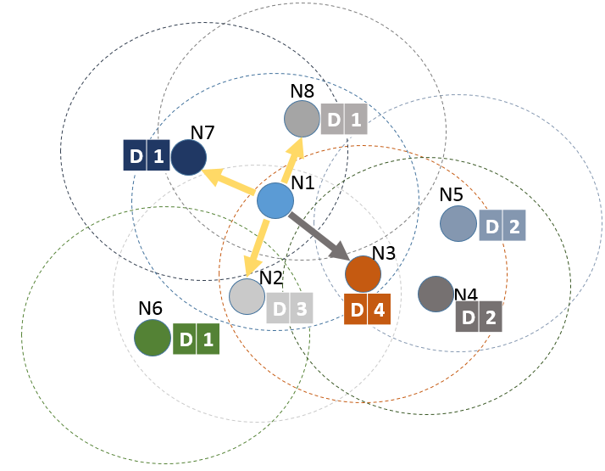
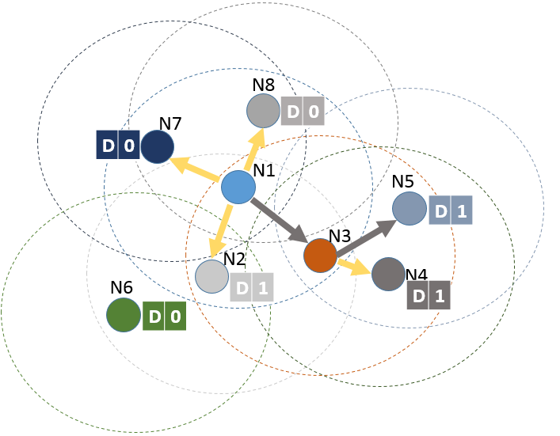
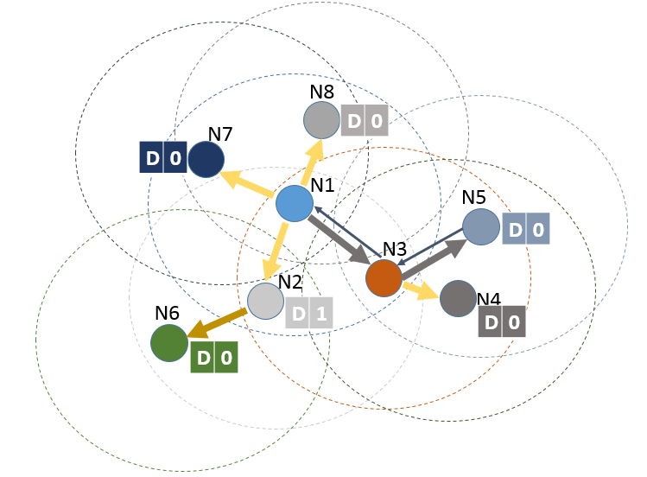
DTSync
Synch. Scheduling
Density-Based Synchronization Scheduling consisting of two processes
Forward-Trace Scheduling Process (FTS)
Select Reference nodes in Shortest hops
Select nodes with high-density neighbors
Backward-Trace Scheduling Process (BTS)
The last ref. node starts broadcasting a BTS pkt.
Non-ref. nodes that received the BTS checks their DT table for unscheduled nodes.
Elect itself as a local Ref if it has unscheduled nodes
FTS Process
BTS Process

Slide 9
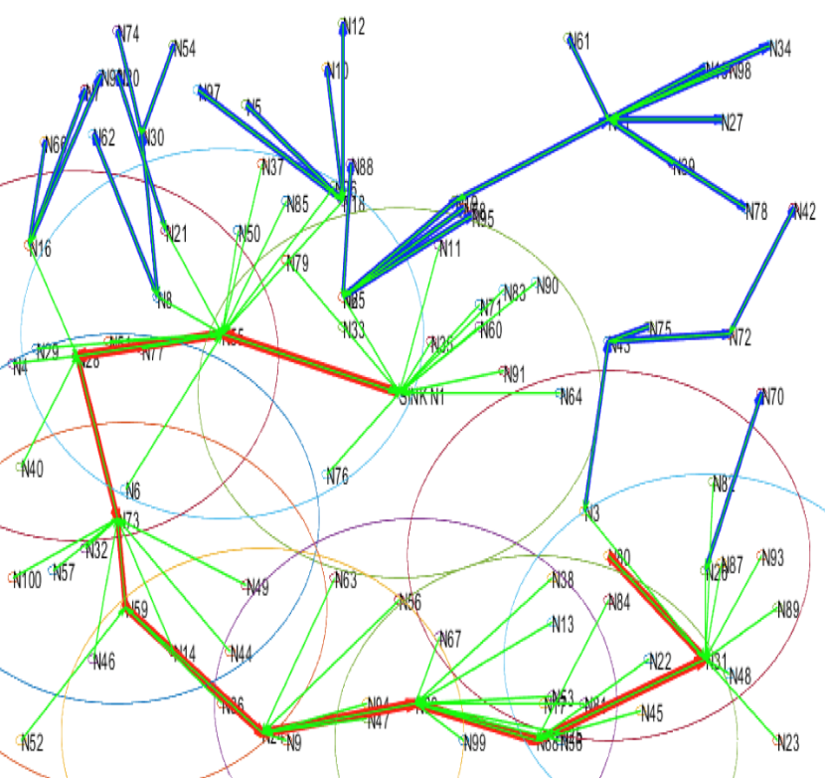
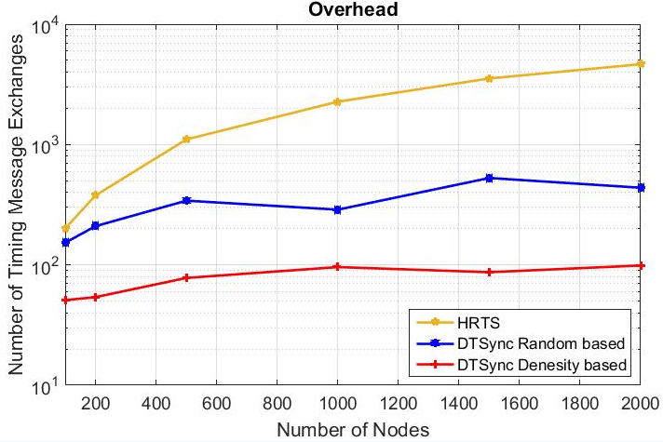
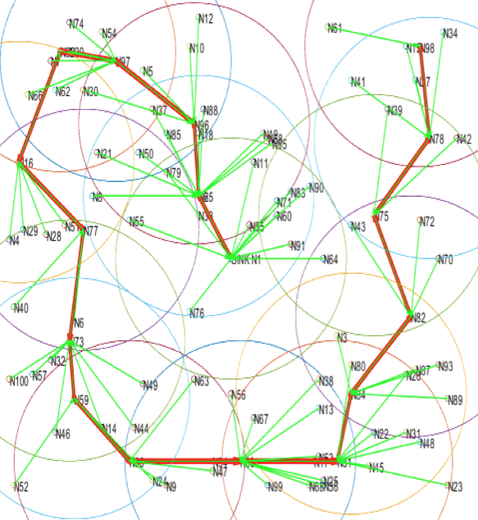
DTSync
Experimental Results
Tested with various networks of 200 ~ 2000 nodes
DTSync with Density Table provides best results: ➔ 400 times fewer Timing messages compared with HRTS method.
Results: Network of 200 nodes
HRTS Method
DTSync with Random
DTSync with Density
DTSync with
Based on density
DTSync with
Random Selection

Slide 10
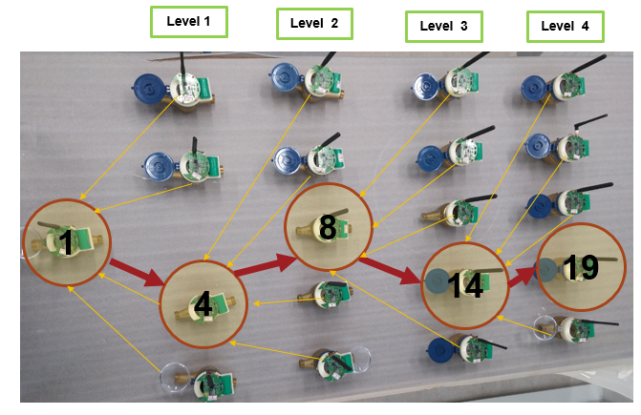
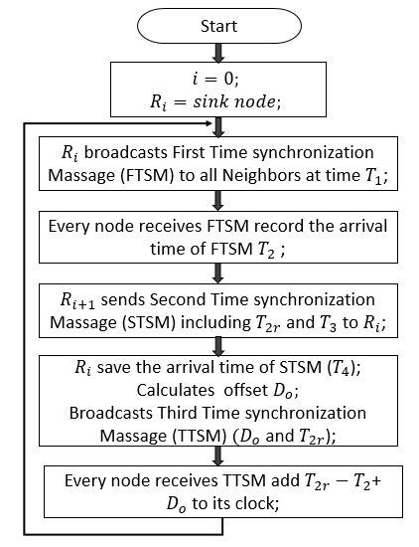
Multi-Hop Multi-Channel Network Demo
Synch. Scheduling
Density-Based Synchronization Scheduling
Select Reference nodes in Shortest hops
Select nodes with high-density neighbors
Periodic Synchronization
Only the reference nodes triggers synch. messages
Periodic Synchronization

Slide 11
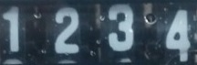

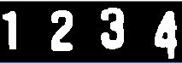
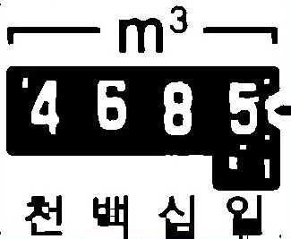

Number Recognition Using Sliding Window
Number Recognition Procedure
Original image
Preprocessing
Segmentation
Feature extraction
Classification
Offset 0
Offset 1
Offset 2
Sliding Window Based Template Matching Algorithm
Offset 3
Histogram projection for finding the bounding box of numbers
Template matching Algorithm for Rotated Number Recognition
Template Image Offset provides Sliding amount of the window
Provide a fractional number from the offset
Offset 4
Offset 5
Offset 6
Offset 7
Offset 1
1.8
Offset 8
Offset 9
1
0.8

Slide 12
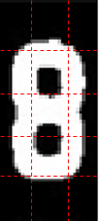
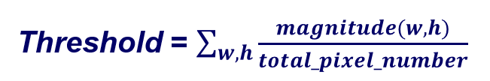
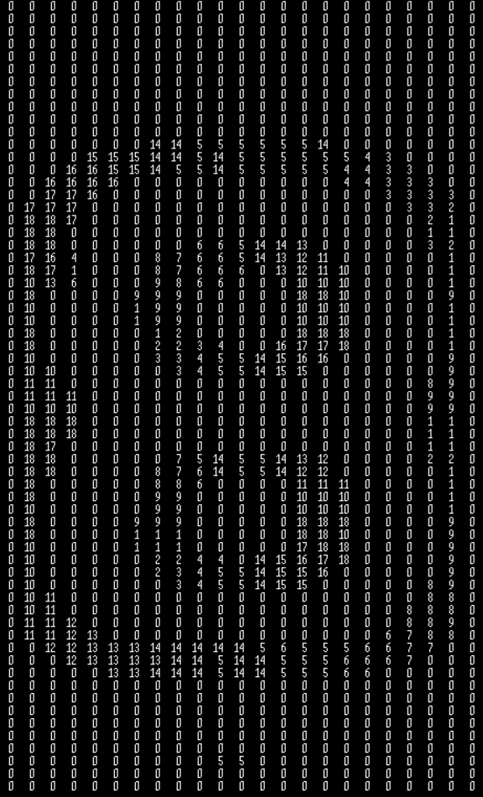
Light-weight Neural-Network
(1)
(2)
(3)
Low Complexity Feature extraction
Normalized Density for Scale-Invariance
(4)
(5)
(6)
Normalized Gradient for enhanced accuracy
Adaptive gradient threshold
Pixel gradient directions are quantized to 18 bins
(7)
(8)
(9)
(10)
(11)
(12)
(13)
(14)
(15)
Input
Layer
Hidden
Layer
Output
Layer
< Density >
Bias
(1)
(2)
(3)
1
Bias
1
Number 0
2
Input 1 : Density (1)
1
2
Number 1
Input 2 : Density (2)
2
.
.
.
.
.
.
.
.
.
.
.
.
3
(4)
(5)
(6)
.
.
.
.
.
.
Number 2
.
.
.
.
.
.
.
.
.
.
.
.
4
Number 3
13
5
(7)
(8)
(9)
Input 15 : Density (15)
15
Number 4
16
14
6
Input 16 : Gradient (1)
Number 5
Input 17 : Gradient (2)
17
15
7
(10)
(11)
(12)
.
.
.
.
.
.
.
.
.
.
.
.
.
.
.
.
.
.
Number 6
.
.
.
.
.
.
.
.
.
.
.
.
8
Number 7
33
9
(13)
(14)
(15)
Input 29 : Gradient (14)
29
Number 8
Input 30 : Gradient (15)
30
34
10
Number 9
< Gradient Direction >
35

